Slide 1

Dining Philosophers
Pichl und Elias

Slide 2
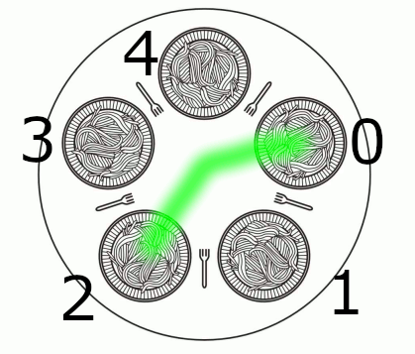
Our example:
A Woodworker glues woodpieces together
Every woodpiece needs 2 components of a glue
We assume that every woodworker continuously wants to glue a piece toegether. We have to manage that.
Not manage it at all -> stalemate
Tries pick up a first glue. if it fails, lay down your glue and try again later.
Only one woodworker can glue a workpiece at a time.
Our solution: pattern – every second Woodworker can glue a workpiece together
We will show the implementation now.

